Slide 1

DAYANANDA SAGAR ACADEMY OF TECHNOLOGY & MANAGEMENT
(An Autonomous Institute under VTU)
Department of CSE-Cyber Security
^{6th} Semester 2026-27
Project Phase 1- First Review
SHADOW-CODE: AGENTIC AI FRAMEWORK FOR AUTONOMOUS SECURE SDLC AUDITING
1DT23CY040 : SACHIN SHEKHAR
1DT23CY002 : ABHINAV RAJ
1DT23CY022 : IKSHIT SINHA
1DT23CY003 : ABHISHEK ANAND
GUIDE NAME: Mr. Anitha R ,
ASSOCIATE PROFESSOR

Slide 2
Index
Abstract
Introduction
Literature Survey
Motivation
Contribution
Architecture
Abstract
Introduction
Literature Survey
Motivation
Contribution
Architecture
Implementation status

Slide 3
Abstract
Problem Statement: The acceleration of modern CI/CD pipelines has significantly increased the risk of introducing vulnerabilities, while current automated auditing tools struggle to keep pace with complex, context-dependent flaws.
Security Gap: Traditional Static Application Security Testing (SAST) relies exclusively on rigid, rule-based pattern matching. This approach misses semantic intent and business logic vulnerabilities, resulting in high false-positive rates and developer alert fatigue.
Solution: An autonomous, multi-agent DevSecOps security layer that intercepts code commits and performs deep logical analysis before allowing changes to merge into the main repository.
Proposed Framework: Shadow Code utilizes a coordinated pipeline of 8 specialized AI agents. Driven by LLM-based reasoning, it moves beyond syntax checking to understand the actual meaning of the code, map findings to real-world CVEs, and generate secure, automated fixes.
Adaptive Intelligence: The system features a continuous human-in-the-loop feedback mechanism that learns from developer interactions. It dynamically calibrates severity rankings per repository, learning team-specific coding patterns to minimize unnecessary warnings over time.
Dayananda Sagar Academy of Technology & Management
(Autonomous Institute under VTU)

Slide 4
Introduction
Aim:
Shadow Code integrates an autonomous, multi-agent AI framework directly into CI/CD pipelines to shift security auditing left. By using LLM-based semantic reasoning, it detects complex logical vulnerabilities missed by traditional scanners and continuously reduces false positives through an adaptive developer feedback loop.
Objectives
Shift Security Left: To intercept code at the earliest stage of the Software Development Life Cycle (SDLC) by integrating directly into the developer's commit process.
Continuous CI/CD Auditing: To establish an automated, real-time security monitoring system that operates at the speed of modern agile development pipelines.
Semantic Reasoning: To utilize Large Language Models (LLMs) to analyze the actual meaning and intent of code, moving beyond the limitations of rigid, rule-based scanning.
Automated Remediation: To not only detect flaws but proactively generate secure, context-aware code fixes to help developers resolve issues immediately.
Adaptive Intelligence: To implement a human-in-the-loop feedback mechanism continuously reduce false positives.
Dayananda Sagar Academy of Technology & Management
(Autonomous Institute under VTU

Slide 5
Literature Survey
Paper Title | Author | Year | Gaps Identified (Addressed by Shadow Code) | Techniques Used
LLMs in Software Security: A Survey of Vulnerability Detection Techniques and Insights | Z. Sheng, et al. (arXiv) | 2025 | Struggles with high false-positive rates; lacks a multi-agent orchestration system directly integrated into the developer's Git push pipeline. | Single-agent LLM analysis (GPT, CodeBERT), Static/Dynamic analysis integration.
From Large to Mammoth: A Comparative Evaluation of LLMs in Vulnerability Detection | NDSS Symposium | 2025 | Focuses solely on detection rather than remediation; performance fluctuates heavily without traditional static tools (like Semgrep) acting as a pre-filtering layer to save tokens. | File-level vulnerability classification using open-source models (LLaMA-3, Mistral, Gemma).
Detecting Code Vulnerabilities using LLMs | IEEE DSN | 2025 | Patching success rate is limited because it lacks an adaptive feedback loop (like Agent 8) that learns from human developer overrides and team-specific coding styles. | Dynamic prompt engineering, Zero-shot Chain-of-Thought (CoT), LLM-based vulnerability patching.
LLM-Based Multi-Agent Systems for Software Engineering: Literature Review and Vision | X. Yin, et al. (arXiv) | 2024 | Highly theoretical; lacks an end-to-end functional architecture that handles everything from initial code parsing (tree-sitter) to automated CVE mapping via Vector Databases (ChromaDB). | Multi-agent collaboration frameworks, role-playing agents (Tester vs. Developer), Consensus-based classification.
Dayananda Sagar Academy of Technology & Management
(Autonomous Institute under VTU

Slide 6
Motivation
The primary motivation behind Shadow Code is to solve the growing disconnect between high-speed software development and effective security auditing. As applications grow more complex, relying on slow manual reviews or rigid scanners leaves critical systems exposed to cyber-attacks.
The Cost of Late Detection: Finding and fixing a vulnerability in production is exponentially more expensive—and dangerous—than catching it during the initial developer commit.
Developer Alert Fatigue: Current security tools generate overwhelmingly high rates of false positives, causing developers to lose trust in the system and ignore potentially critical warnings.
The "Logic" Gap: Modern cyber-attacks frequently exploit complex business-logic flaws. Traditional rule-based scanners are fundamentally blind to these because they cannot understand a developer's semantic intent.
Proactive Security: We are driven by the need to transform security from a "roadblock" into an enabler, providing developers with an intelligent assistant that actively suggests fixes rather than just highlighting errors.
Dayananda Sagar Academy of Technology & Management
(Autonomous Institute under VTU

Slide 7
Contribution
Real-Time Threat Intelligence (RAG Integration): Implementing a Retrieval-Augmented Generation (RAG) pipeline to instantly map uncommitted code vulnerabilities to real-world, global CVEs (Common Vulnerabilities and Exposures) from the NVD database.
Intelligent Token Optimization: Designing a hybrid pipeline where fast, deterministic tools (like Semgrep) act as a pre-filter. This eliminates 80-90% of safe code before it reaches the LLMs, drastically reducing computational costs and API token usage.
Fail-Safe Remediation Architecture: Engineering a "Surgeon" agent that doesn't just rewrite code, but takes a pre-fix snapshot, runs an automated syntax check on the AI's fix, and automatically rolls back if the LLM hallucinates or breaks the build.
Dual-Layer Interception Modes: Developing a flexible architecture that can operate as a "Strict Mode" local pre-push hook on the developer's machine, or a "Review Mode" CI/CD gate in the cloud, allowing hybrid deployment
Dayananda Sagar Academy of Technology & Management
(Autonomous Institute under VTU

Slide 8
Architectural Flow:
The architecture of Shadow Code follows a "Sequential & Reactive" workflow, orchestrated by LangGraph. It is designed to act as a security gate between a local machine and the remote repository.
Stage 1: The Trigger & Interception
Action: A developer executes a git push command in the terminal.
Interception: The Shadow Code Gateway intercepts the push. The code is placed in a "Quarantine State" (it cannot reach GitHub yet).
Activation: The Orchestration Engine (LangGraph) triggers the multi-agent pipeline.
Stage 2: Structural Analysis & Pre-Filtering
Agent 1: The Parser (The Receptionist): - Uses tree-sitter to build an Abstract Syntax Tree (AST).
  Chunks the code into logical blocks (functions/classes).
  Filters out non-code files (images, logs) to save processing power.
Agent 2: Pattern Scanner (The Filter): - Runs deterministic tools like Semgrep, Bandit, or ESLint.
  Catches "low-hanging fruit" (known syntax vulnerabilities).
  Optimization: If code passes this stage without flags, it is marked as "low risk" to optimize token usage.
Stage 3: Semantic Reasoning & Threat Intel
Agent 3: Semantic Reasoner (The Doctor): - The core LLM (Llama 3.3 / Claude) analyzes the intent of the code.
  Identifies deep logic flaws (e.g., broken access control, insecure business logic) that patterns cannot catch.
Agent 4: CVE Correlator (The Historian): - Queries a Vector Database (ChromaDB) containing the NVD (National Vulnerability Database).
Dayananda Sagar Academy of Technology & Management
(Autonomous Institute under VTU

Slide 9
Architectural flow:-
Stage 4: Evaluation & Ranking
Agent 5: Severity Ranker (The Judge): - Assigns a CVSS score (Critical, High, Medium, Low).
  Factors in context: Is this code on a public-facing endpoint or a private internal utility?
Stage 5: Remediation & Reporting
Agent 6: Report Writer (The Communicator): - Translates complex technical jargon into a plain-English report.
  Highlights the vulnerable lines and explains why they are dangerous.
Agent 7: The Surgeon (The Fixer): - Generates a specific, secure code replacement.
  Fail-Safe: Runs a syntax check on the suggested fix to ensure it doesn't break the build.
Stage 6: The Feedback Loop (The Learning Phase)
SOC Dashboard Interaction: The developer views the findings on the Shadow Code UI.
Action: The developer either "Applies the Fix" or "Overrides" the warning.
Agent 8: Adaptive Memory (The Learner): - Records the developer's decision.
  If a team consistently overrides a specific warning, Agent 8 lowers the severity for that specific repository in future scans, effectively learning the team's coding style.
Final Step: Deployment
Once the vulnerabilities are resolved or safely bypassed, the system lifts the block and allows the git push to complete, merging the secure code into GitHub.
Dayananda Sagar Academy of Technology & Management
(Autonomous Institute under VTU

Slide 10
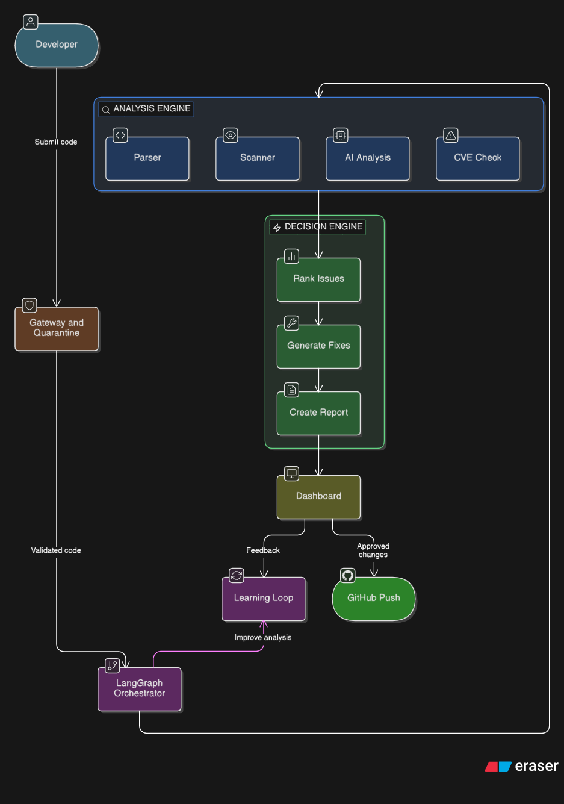
Architectural Design:-
Dayananda Sagar Academy of Technology & Management
(Autonomous Institute under VTU

Slide 11
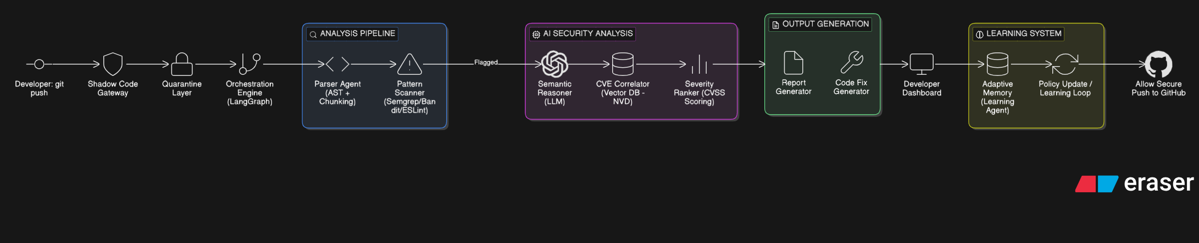

Architectural design:-
Dayananda Sagar Academy of Technology & Management
(Autonomous Institute under VTU

Slide 12
Implementation status
Completed Work
Designed UI/UX for Shadow Code Dashboard
Developed frontend using React
Implemented core features:
  GitHub push tracking interface
  Code analysis result display
  Vulnerability status indicators (Low / Medium / High)
Built interactive dashboard showing:
  All GitHub pushes
  Analysis reports
  Logs & history of scans
In Progress: Implementing AI-based vulnerability insights display
Dayananda Sagar Academy of Technology & Management
(Autonomous Institute under VTU

Slide 13
THANKYOU
Dayananda Sagar Academy of Technology & Management
(Autonomous Institute under VTU

